Slide 1
Anesthesia
Dr. Ashraff Abdulrazaq

Slide 2
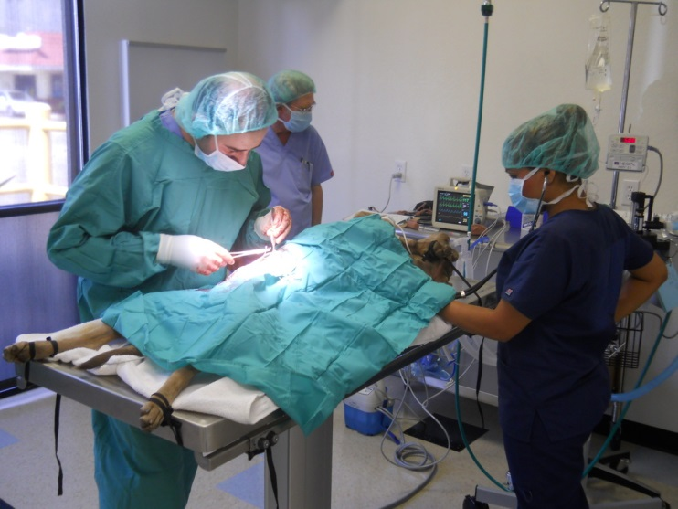
■ Surgery
■ Diagnostic
and therapeutic procedures
■ Restraint
■ Transportation
■ Euthanasia / Slaughter
USES OF GENERAL ANESTHESIA

Slide 3
Definitions
Anesthesia: derived from the Greek anaisthaesia meaning “insensibility”
Analgesia: refers to freedom from or absence of pain
Tranquilization: state of behavioral change that include reduction in anxiety and relaxation
Sedation: central depression accompanied by drowsiness, patient is unaware of surroundings

Slide 4
Narcosis: is a drug induced state of deep sleep
Hypnosis: is a condition of artificially induced sleep
Local anesthesia: loss of sensation in a circumscribed body area
Regional anesthesia: insensibility in a larger, though limited, body area

Slide 5
General anesthesia: drug induced unconsciousness that is characterized by controlled reversible depression of CNS and analgesia. The patient is not arousable, all reflexes are depressed
Surgical anesthesia: is a state of general anesthesia that provide muscle relaxation and analgesia for painless surgery
Balanced anesthesia: is induced by multiple drugs
Dissociative anesthesia: is induced by drugs that dissociate the thalamocortic and limbic systems

